Slide 1
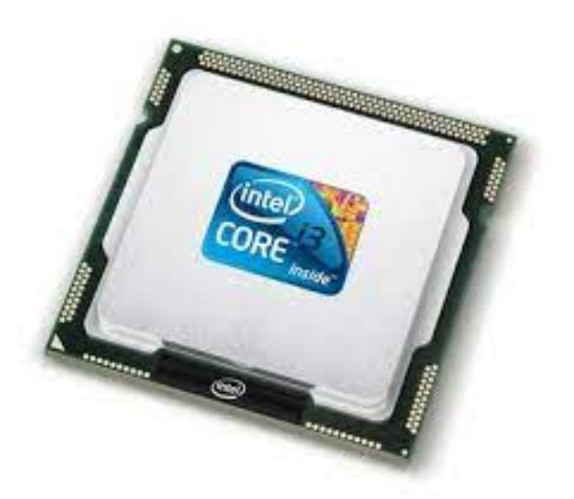
Unit 4.1 - Processor Funfamentals
Prepared by: Koh Kian Hua

Slide 2
Objectives (Part 1)
After completing this unit, students should be able to:
Show understanding of the basic Von Neumann model for a computer system and the stored program concept
Show understanding of the purpose and role of registers, including the difference between general purpose and special purpose registers
Show understanding of the purpose and roles of the Arithmetic and Logic Unit (ALU), Control Unit (CU) and system clock, Immediate Access Store (IAS)
Show understanding of how data are transferred between various components of the computer system using the address bus, data bus and control bus
Show understanding of how factors contribute to the performance of the computer system including: processor type and number of cores, the bus width, clock speed and cache memory.
Understand how different ports provide connection to peripheral devices including connection to: Universal Serial Bus (USB), High Definition Multimedia Interface (HDMI) and Video Graphics Array (VGA)

Slide 3
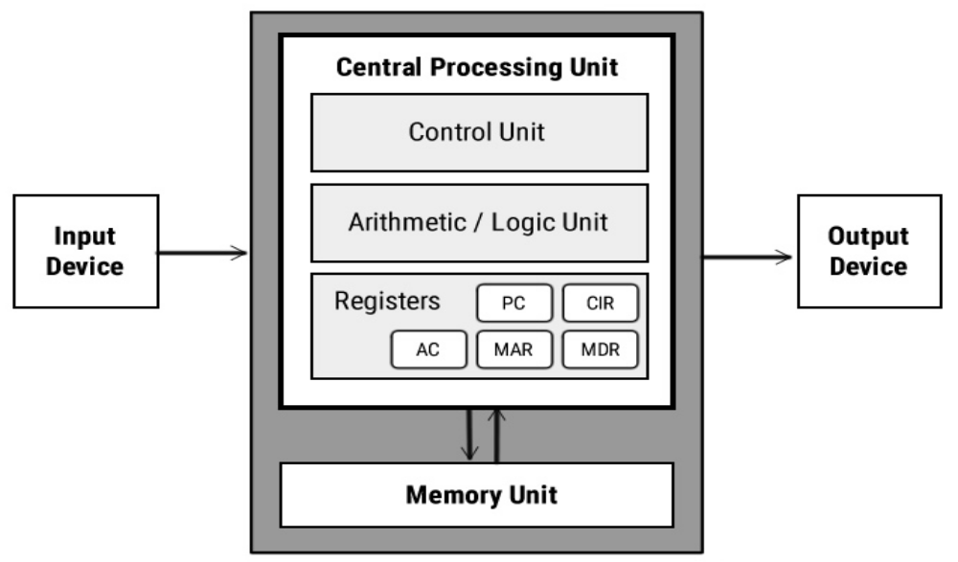
Central Processing Unit
Von Neumann model
Parts of the Von Neumann Architecture:

Slide 4
Central Processing Unit
Components of the Processor (CPU)
Main components of the processor includes:
the arithmetic logic unit (ALU),
the control unit (CU),
the system clock
the immediate access store (IAS)

Slide 5
Central Processing Unit
Components of the Processor (CPU)
Arithmetic logic unit (ALU): The ALU performs arithmetic or logic operations while a program is being run.
  Multiplication and division are carried out by adding, subtracting and left/right shifting operations
  For example, shifting 0 0 1 1 0 1 1 1 two places to the left gives 1 1 0 1 1 1 0 0, which is equivalent to multiplying by a factor of 4.
The accumulator (ACC) is a temporary register used when carrying out ALU calculations.

Slide 6
Central Processing Unit
Components of the Processor (CPU)
Control unit (CU)
This unit controls all the other units of the computer system
It is known as its central nervous system.
It transfers data throughout the computer as required including from storage unit to central processing unit and vice versa.
The control unit also dictates how the memory, input output devices, arithmetic logic unit etc. should behave.
System clock
A system clock is used to produce timing signals on the control bus to ensure this vital synchronisation takes place – without the clock the computer would simply crash.

Slide 7
Central Processing Unit
Components of the Processor (CPU)
Immediate Access Store (IAS)
IAS is where the CPU holds all the data and programs that it is currently using.
Data can be written to and read from IAS electronically at very high speeds.
The IAS allows the computer to immediately access a file or data while it processes the calculations.
Registers
Computer registers are high-speed memory storing units.
It is an element of the computer processor.
It can carry any type of information including a bit sequence or single data.
A register can be 32 bits in length for a 32-bit instruction computer.
Registers can be numbered relies upon the processor design and language rules.

Slide 8
Central Processing Unit
Components of the Processor (CPU)
Common Registers Used in a Compter:
A
Register | Abbreviation | Function / Purpose
Current Instruction Register | CIR | stores the current instruction being decoded and executed
Index register | IX | used when carrying out index addressing operations (assembly code)
Memory Address Register | MAR | stores the address of the memory location currently being read from or written to
Memory Data/ Buffer Register | MDR / MBR | stores data which has just been read from memory or data which is about to be written to memory
Program Counter | PC | stores the address where the next instruction to be read can be found
Status Register | SR | contain bits which can be set or cleared depending on the operation (eg: indicate overflow in a calculation)

Slide 9
Central Processing Unit
Components of the Processor (CPU)
Status Register
A status register is used when an instruction requires some form of arithmetic or logic processing. Each bit is known as a flag.
Most systems have the following four flags.
  Carry flag (C) is set to 1 if there is a CARRY following an addition operation.
  Negative flag (N) is set to 1 if the result of a calculation yields a NEGATIVE value.
  Overflow flag (V) is set to 1 if an arithmetic operation results in an OVERFLOW being produced.
  Zero flag (Z) is set to 1 if the result of an arithmetic or logic operation is ZERO.

Slide 10
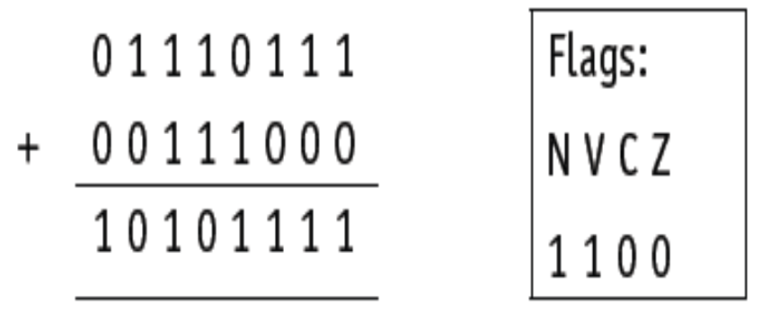
Central Processing Unit
Components of the Processor (CPU)
Status Register
Consider this operation:
Since we have two positive numbers being added, the answer should not be negative.
The flags indicate two errors: a negative result, and an overflow occurred.

Slide 11
Central Processing Unit
Components of the Processor (CPU)
System Buses
(System) buses are used in computers as a parallel transmission component; Each wire in the bus transmits one bit of data.
There are three common buses used in the Von Neumann architecture known as
  address bus,
  data bus and
  control bus.

Slide 12
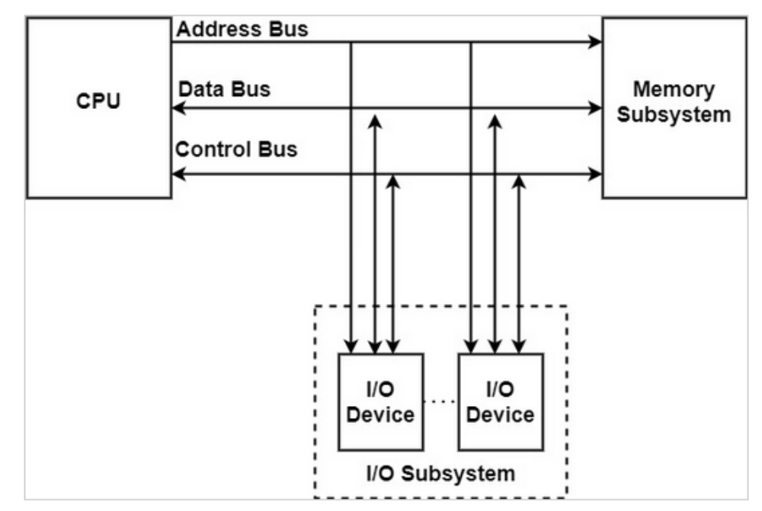
Central Processing Unit
Components of the Processor (CPU)
Diagram of System Bus

Slide 13
Central Processing Unit
Components of the Processor (CPU)
Address Bus
The address bus carries addresses throughout the computer system.
Between the CPU and memory the address bus is unidirectional (in other words, bits can travel in one direction only).
This prevents addresses being carried back to the CPU, which is undesirable.
The width of a bus is important. The wider the bus, the more memory locations which can be directly addressed at any given time

Slide 14
Central Processing Unit
Components of the Processor (CPU)
Data Bus
The data bus is bidirectional. It allows data to be sent in both directions along the bus.
Data can be carried from CPU to memory (and vice versa) as well as to and from input/output devices.
Similar to the address bus, the width of the data bus is important: the wider the bus, the larger the word length that can be transported.

Slide 15
Central Processing Unit
Components of the Processor (CPU)
Control Bus
Lines that carry control signals like clock signals, interrupt signal or ready signal to all other computer components are called control bus.
They are bidirectional.
It is usually 8-bits wide since it only carries control signals.

Slide 16
Central Processing Unit
Components of the Processor (CPU)
System Clock
The clock defines the clock cycle which synchronises all computer operations.
The control bus transmits timing signals, ensuring everything is fully synchronised.
By increasing clock speed, the processing speed of the computer is also increased.

Slide 17
Central Processing Unit
Components of the Processor (CPU)
Performance of Computer
Although the clock speed is increased, it does not necessary mean that the overall performance has improved.
Overall Performance of Computer is affected by
  increasing bus width (data and address buses) increases the performance and speed of a computer system
  increasing clock speed usually increases the speed of a computer
  a computer’s performance can be changed by altering bus width, clock speed and use of multi-core CPUs
  use of cache memories can also speed up a processor’s performance.

Slide 18
Central Processing Unit
Components of the Processor (CPU)
Computer Ports
Input and output devices are connected to a computer via ports. The interaction of the ports with connected input and output is controlled by the control unit. The more common types of computer ports are:
USB cable
HDMI cable
VGA cable

Slide 19
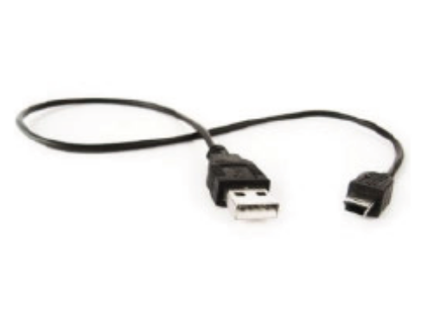
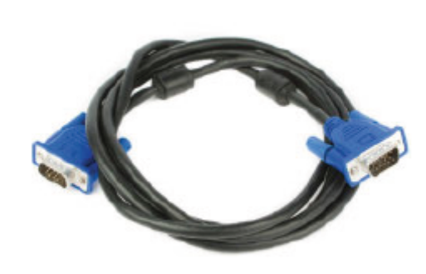
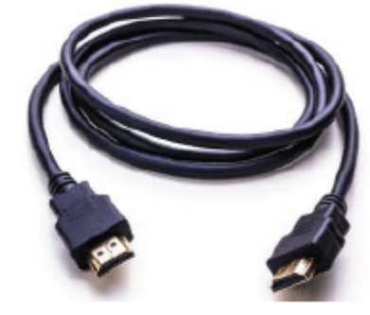
Central Processing Unit
Components of the Processor (CPU)
Computer Ports
Input and output devices are connected to a computer via ports. The interaction of the ports with connected input and output is controlled by the control unit. The more common types of computer ports are:
USB (Universal Serial Bus) cable
HDMI cable
VGA cable

Slide 20
Central Processing Unit
Pros and Cons of USB System
The USB system has become the industry standard, but there are still advantages and disadvantges to using this system.
Pros of USB system | Cons of USB System
devices plugged into the computer are automatically detected and device drivers are automatically loaded up | the present transmission rate is limited to less than 500 megabits per second
the connectors can only fit one way, which prevents incorrect connections being made | the maximum cable length is presently about five metres
this has become the industry standard, which means that considerable support is available to users | the older USB standard (such as 1.1) may not be supported in the near future
several different data transmission rates are supported
newer USB standards are backward compatible with older USB standards

Slide 21
Central Processing Unit
High-definition multimedia interface (HDMI)
Characteristics:
They support high definition signals (enhanced or standard).
HDMI was introduced as a digital replacement for the older Video Graphics Array (VGA) analogue system.
HDMI require more data, which has to be received at a much faster rate than with older televisions (around 10 gigabits per second).
HDMI increases the bandwidth, making it possible to supply the necessary data for high quality sound and visual effects.

Slide 22
Central Processing Unit
Video Graphics Array (VGA)
Characteristics:
VGA was introduced at the end of the 1980s. VGA supports 640 × 480 pixel resolution on a television or monitor screen.
It can also handle a refresh rate of up to 60 Hz (60 frames a second) provided there are only 16 different colours being used.
If the pixel density is reduced to 200 × 320, then it can support up to 256 colours.

Slide 23
Central Processing Unit
Video Graphics Array (VGA)
Characteristics:
VGA was introduced at the end of the 1980s. VGA supports 640 × 480 pixel resolution on a television or monitor screen.
It can also handle a refresh rate of up to 60 Hz (60 frames a second) provided there are only 16 different colours being used.
If the pixel density is reduced to 200 × 320, then it can support up to 256 colours.

Slide 24
Central Processing Unit
High-definition multimedia interface (HDMI)
Pros and Cons of HDMI :
Pros of HDMI | Cons of HDMI
the current standard for modern televisions and monitors | not a very robust connection (easy to break connection when simply moving device)
allows for a very fast data transfer rate | limited cable length to retain good signal
improved security (helps prevent piracy) | there are currently five cable/ connection standards
supports modern digital systems | HDMI cables are expensive compare to analog cables (eg: VGA)
HD signals are transmitted without any compression and hence there is no degradation in the quality of the signal

Slide 25
Central Processing Unit
Video Graphics Array (VGA)
Pros and Cons of VGA :
Pros of VGA | Cons of VGA
simpler technology | old out-dated analogue technology
only one standard available | it is easy to bend the pins when making connections
it is easy to split the signal and connect a number of devices from one source | the cables must be of a very high grade to ensure good undistorted signal
the connection is very secure

Slide 26
Central Processing Unit
Video Graphics Array (VGA)
Pros and Cons of VGA :
Pros of VGA | Cons of VGA
simpler technology | old out-dated analogue technology
only one standard available | it is easy to bend the pins when making connections
it is easy to split the signal and connect a number of devices from one source | the cables must be of a very high grade to ensure good undistorted signal
the connection is very secure

Slide 27
Central Processing Unit
Class Activity
Two features of Von Neumann architecture are the use of registers and the use of buses. Give the names of two registers and two buses and briefly explain their functionalities.

